Slide 1

A VALUE SENSITIVE ABM OF THE REFUGEE CRISIS IN THE NETHERLANDS
Ross Gore, Phillip Wozny, Frank Dignum, F. LeRon Shults, Christine Boshuijzen - van Burken & Lamber Royakkers email: ross.gore@gmail.com | model website: https://rgore-vmasc.shinyapps.io/integration-model/
Refugee Wellbeing & Asylum Logistics in terms of Schwartz Values

Slide 2

Goal
Make high-level recommendations for decision makers by modeling asylum logistics and refugee wellbeing given the universal values of the entities involved in the process.
Research Questions:
How can worst case outcomes be avoided?
How do we create an environment for best case outcomes?
Enable High-Level Decisions: Avoid Worst Case; Create Environment For Best Case

Slide 3
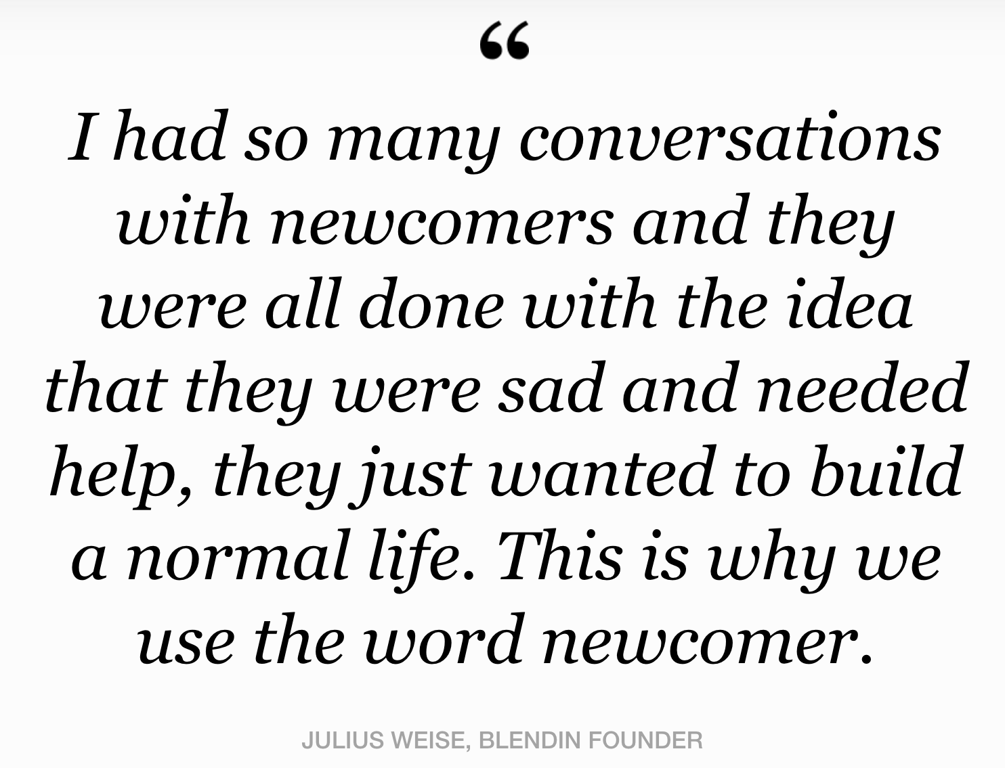
Newcomers
Preferred term in The Netherlands
Politically Neutral
Enables clarity: refugee denotes a specific legal status
Newcomer is an individual in the model. Refugee is a legal status of an individual.

Slide 4


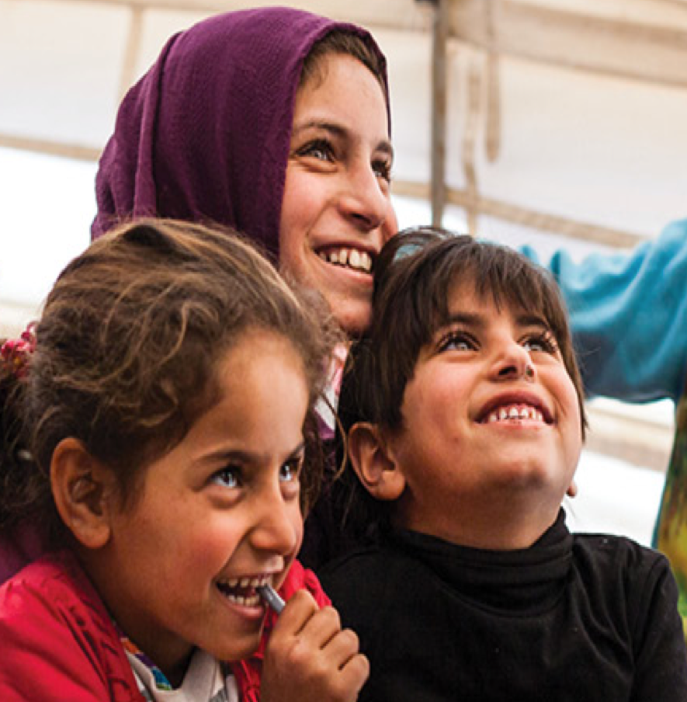

Four Entities In Our Model
NGOs support newcomers both during and after the process by providing information, resources and organizing activities. NGOs are not a required entity in the asylum procedure.
COA checks in, and provides housing and activities to newcomers based on legal status. Also maintains the provided housing.
Newcomer goes through the asylum procedure living in housing provided by COA with the opportunity to participate in activities provided by the COA and NGO.
IND interviews and decides which newcomers can stay. Decision based on documentation quality of newcomer. Decision can be appealed once.
Four Entities, All With Different Values, Participating In One Asylum Procedure

Slide 5
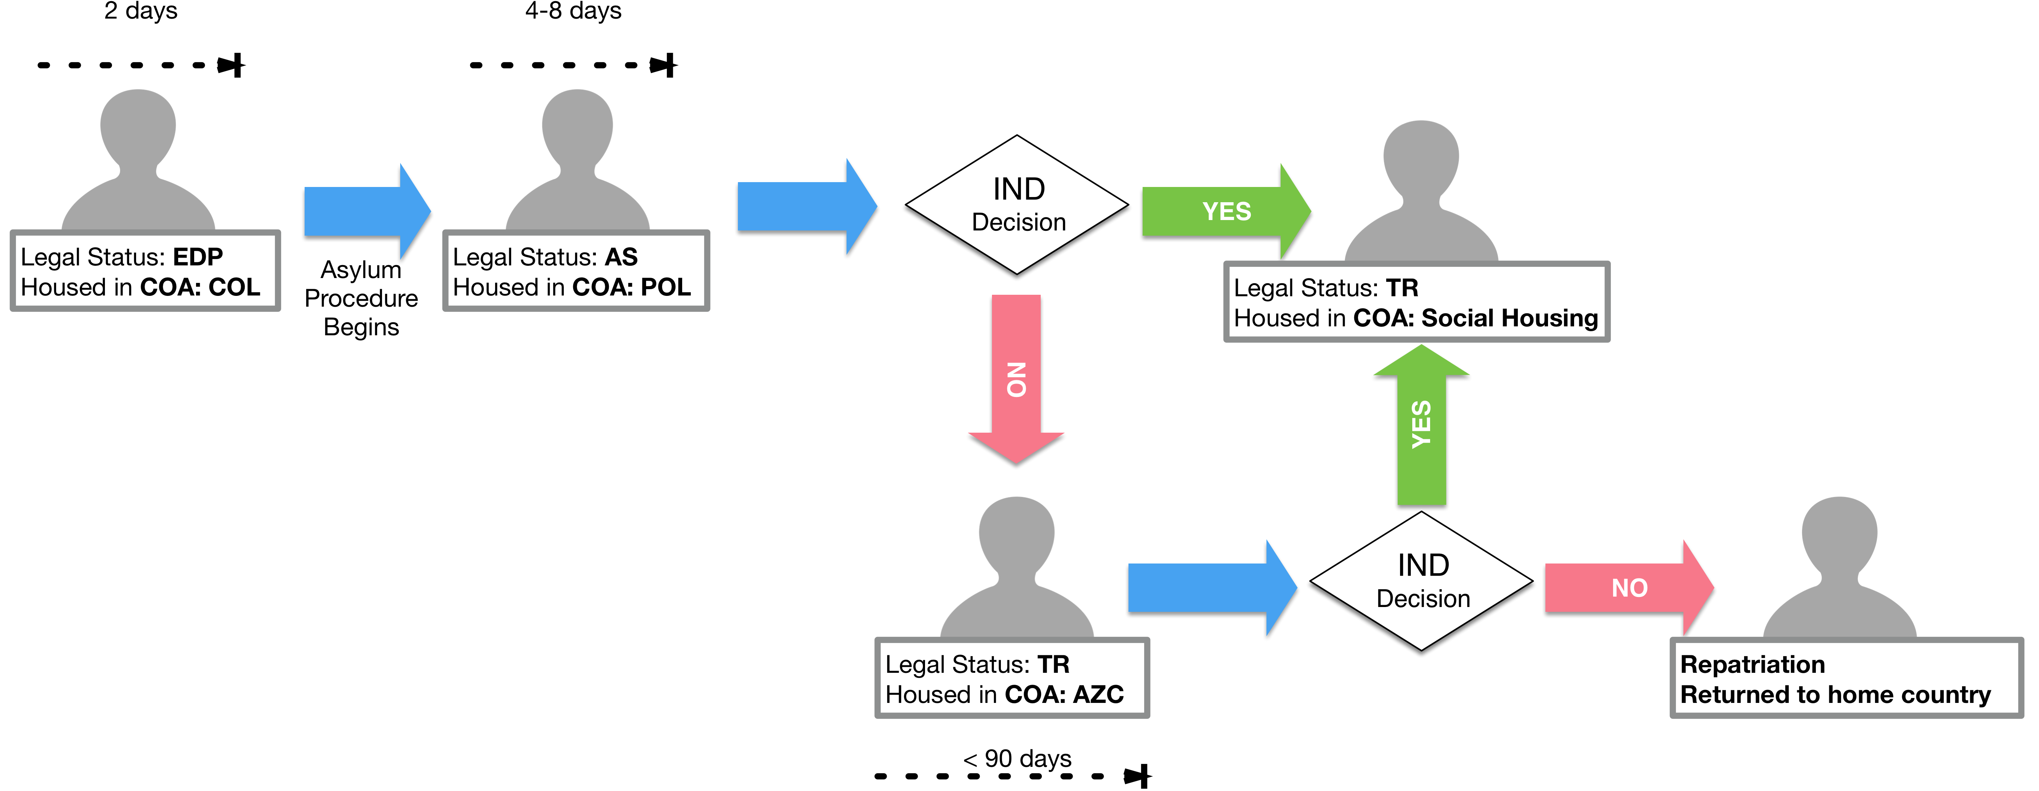
General Dutch Asylum Procedure
3 Legal Statuses (EDP, AS and TR) and as many as 2 Different Decision Opportunities

Slide 6
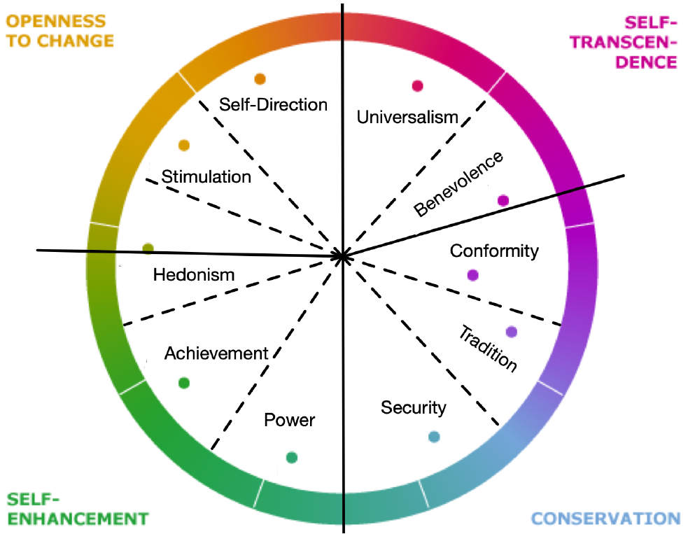
Circle of Schwartz’s Theory Values
Abstract drivers of behavior that shape the way in which humans interact to survive and thrive.
10 values within inner circle placed according to their placement.
4 Schwartz Value Quadrants (SVQs) represented by outer circle.
SVQs opposite undermine each others satisfaction. Reflects the two dimensions of SVQs:
Gain vs. Loss Avoidance
Individual vs. Social
10 Universal Values Divided Into 4 Quadrants across 2 Axes

Slide 7
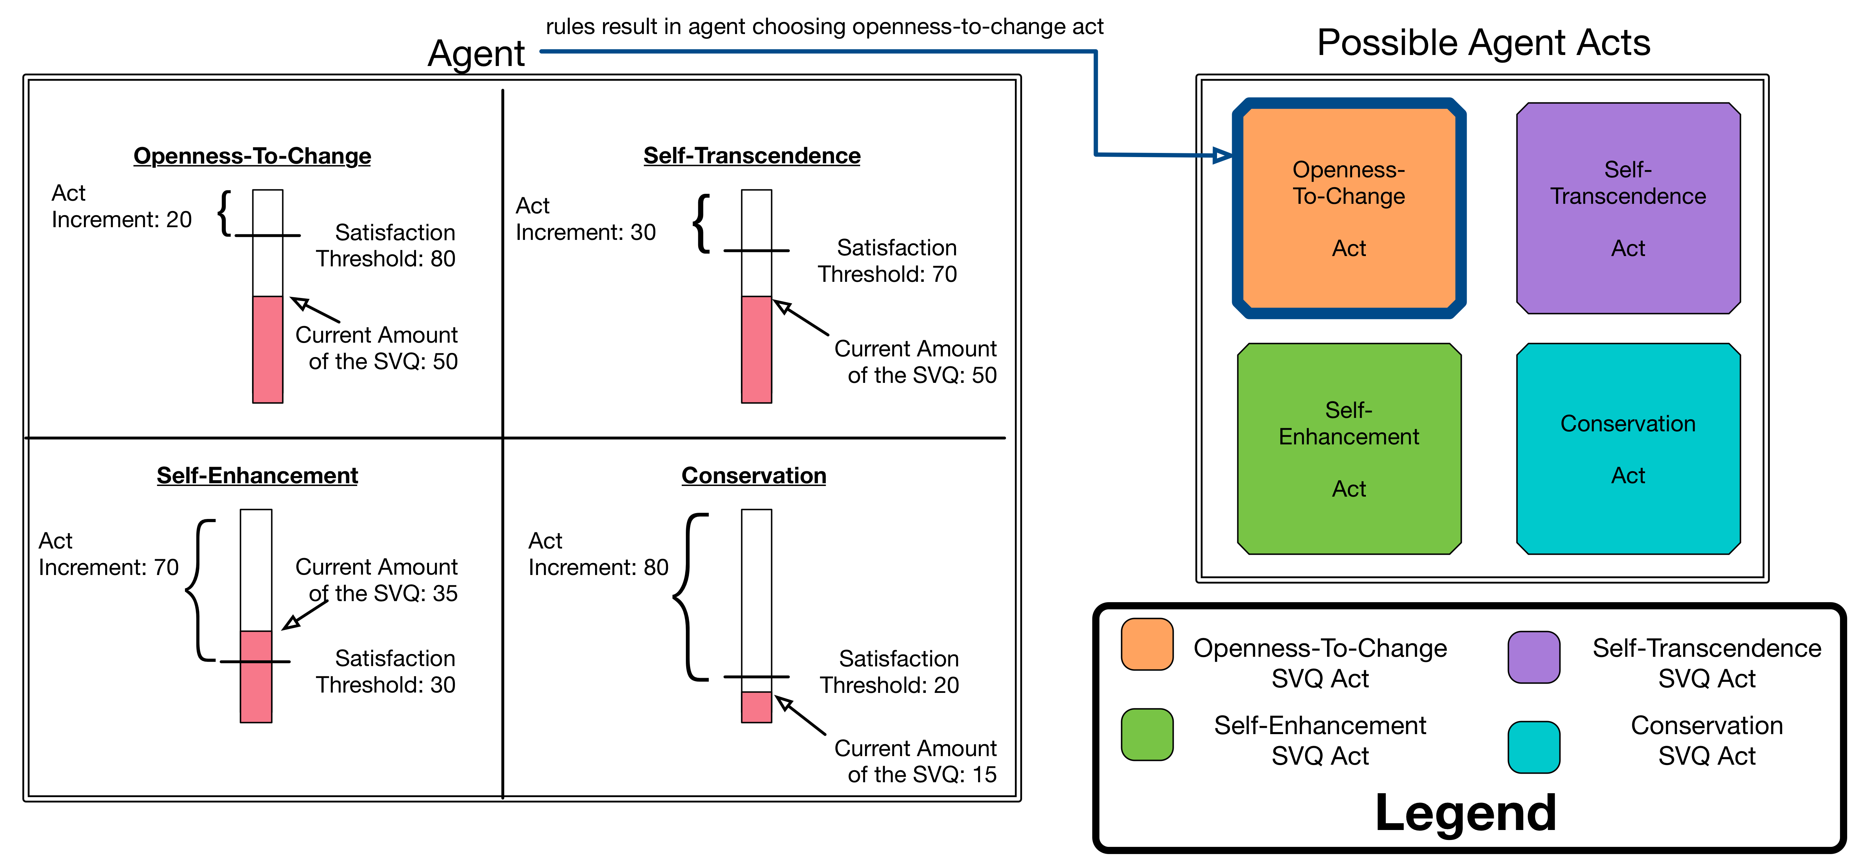
Implementing Schwartz Values For Model Entities
Agent has for each SVQ:
Current amount [0-100]
Decays over time
Threshold
Act Increment
Satisfied when Current amount > Threshold
Agent chooses SVQ act that once complete is still the most furthest distance from the threshold.
Agents most frequently take SVQ act with the highest threshold.

Slide 8
Agent Actions: Newcomer
Obligatory Acts
IND Interview - Begins asylum process for the newcomer.
Doctor - Improves newcomer health if it falls below threshold.
SVQ Activities
Custom Activities - Can only be developed by NGO. Variable SVQ.
Volunteer - Requires NGO to be present. Self-Transcendence. Improves public opinion of newcomers.
Language Class - Requires newcomers to be at most mature legal status (TR). Conservation.
Football - Openness-To-Change.
Work - Self-Enhancement.
Study - Self-Enhancement
Crime - Self-Enhancement. Only occurs when Self-Enhancement is extremely unsatisfied and wellbeing is very low. Reduces public opinion of newcomers.
Any obligatory act must be completed before an agent can choose a SVQ act.

Slide 9
Agent Actions: COA
Obligatory Acts
Checkin Newcomer - Begins asylum process for the newcomer.
Construct Accommodation - Improves newcomer health if it falls below threshold.
SVQ Activities
Segregate - Separate newcomers into better and worse living accommodations based on their chance of receiving a positive IND decision. Conservation.
Improve Facilities - Improve / maintain buildings where newcomers live. Self-Enhancement.
Invest - Provide newcomers with a travel voucher to travel to other cities to meet unsatisfied SVQs. Self-Transcendence.
Adjust Staff - Increases staffing at living accommodations ensuring newcomers receive travel vouchers when they are provided. Openness-To-Change.
Any obligatory act must be completed before an agent can choose a SVQ act.

Slide 10
Agent Actions: IND
Obligatory Acts
Interview Newcomer - Begins the asylum process from the IND perspective. Paired with a newcomer's IND Interview.
Decide Newcomer - Decides on a newcomer’s asylum case. Paired with change in legal status of a newcomer.
SVQ Activities
Raise Threshold - Raises the threshold on newcomer documentation quality in Decide Newcomer obligatory act. Conservation.
Issue Statement - Generates a press release telling newcomer's not to come to the country to begin the asylum process. Self-Enhancement.
Adjust Staff - Increases staffing making asylum process take less time. Self-Transcendence.
Lower Threshold - Lowers the threshold on newcomer documentation quality in Decide Newcomer obligatory act. Openness-To-Change.
Any obligatory act must be completed before an agent can choose a SVQ act.

Slide 11
Agent Actions: NGO
SVQ Activities
Fundraise - Converts public opinion of newcomers to funds for NGO. Conservation.
Conduct Marketing Campaign - Converts funds into an increase in public opinion of newcomers. Self-Enhancement.
Custom Activities - NGO identifies the most unsatisfied SVQ among the newcomers in the city and develops an activity to satisfy it. Self-Transcendence.
Prioritize - NGO schedules Custom Activities on days so that they can best help the newcomers who need them to satisfy their SVQs. Openness-To-Change.
Any obligatory act must be completed before an agent can choose a SVQ act.

Slide 12
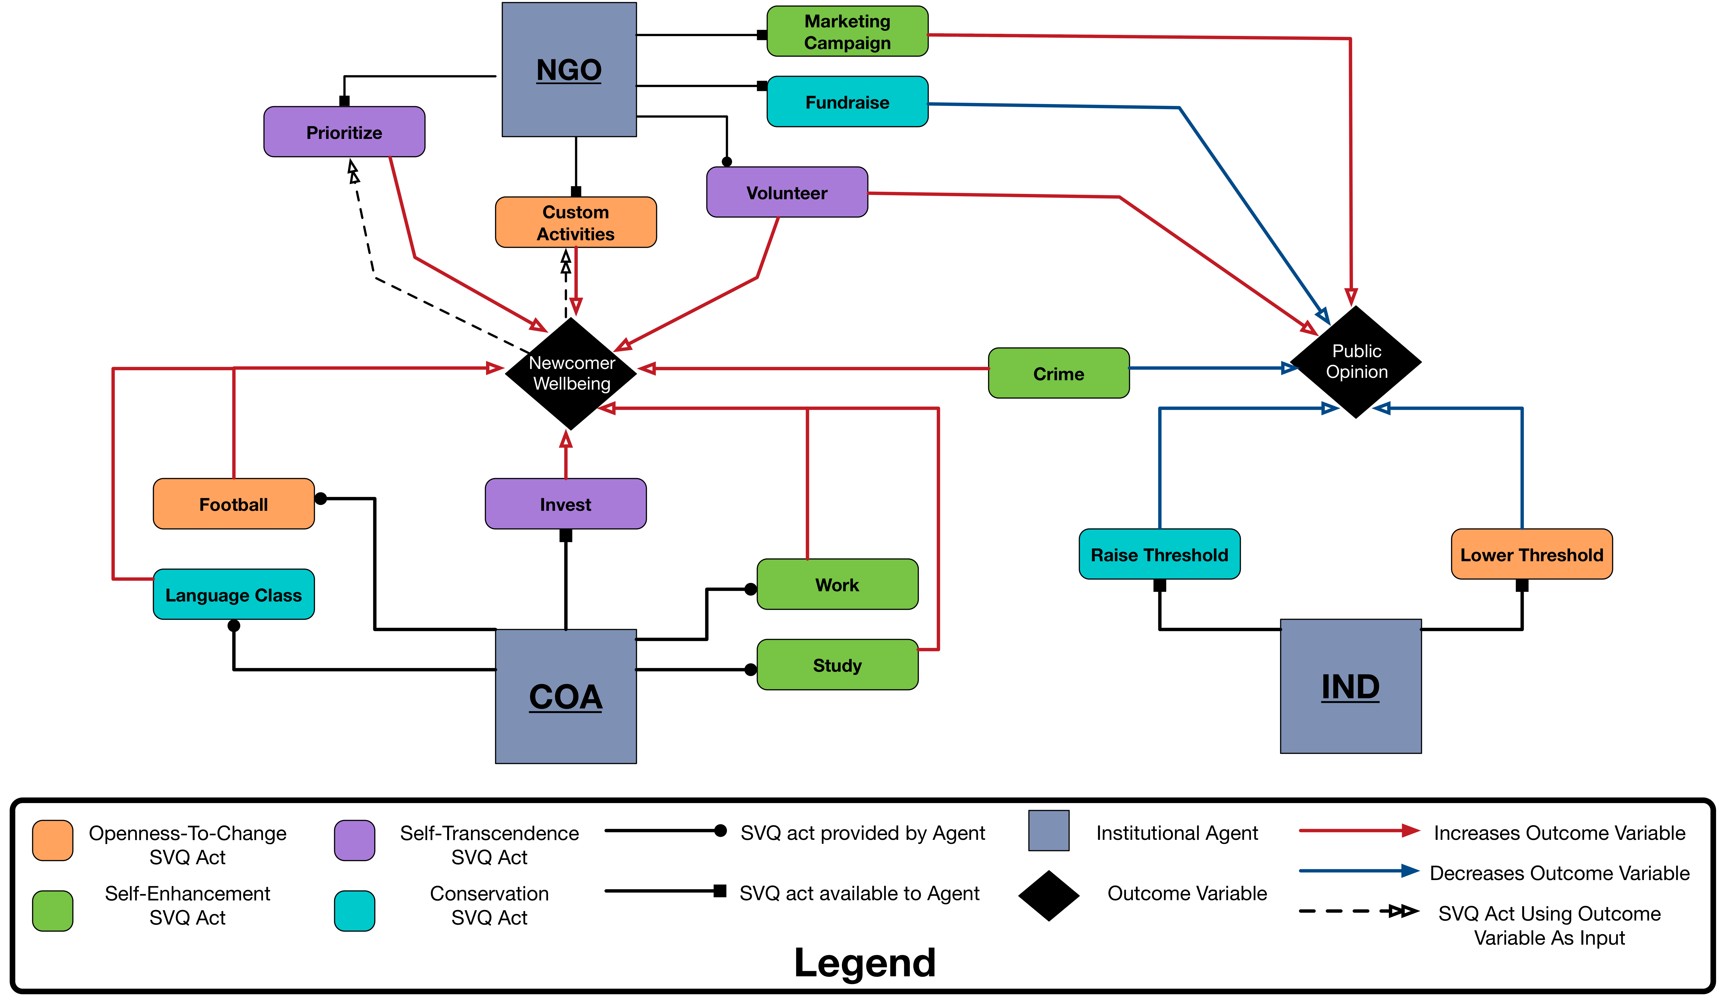
Model Dynamics With Respect To Newcomers
Indirect effects on newcomer wellbeing and public opinion not shown.
Direct and indirect effects of other actions on other outcomes are not shown.
Direct effects of SVQ acts on newcomer wellbeing and public opinion.

Slide 13
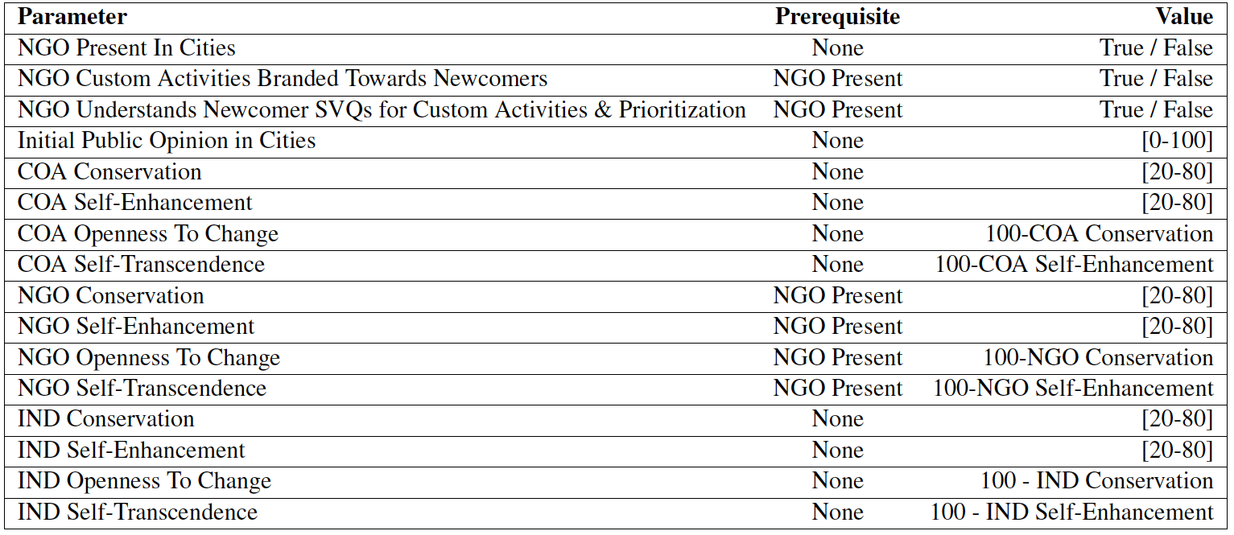
Model Parameters
Newcomer SVQ Thresholds are uniformly randomly distributed.

Slide 14
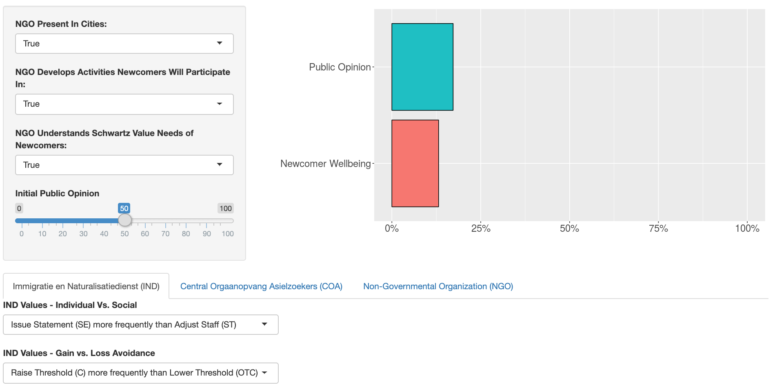
Explore The Model
Try it yourself: https://rgore-vmasc.shinyapps.io/integration-model/

Slide 15
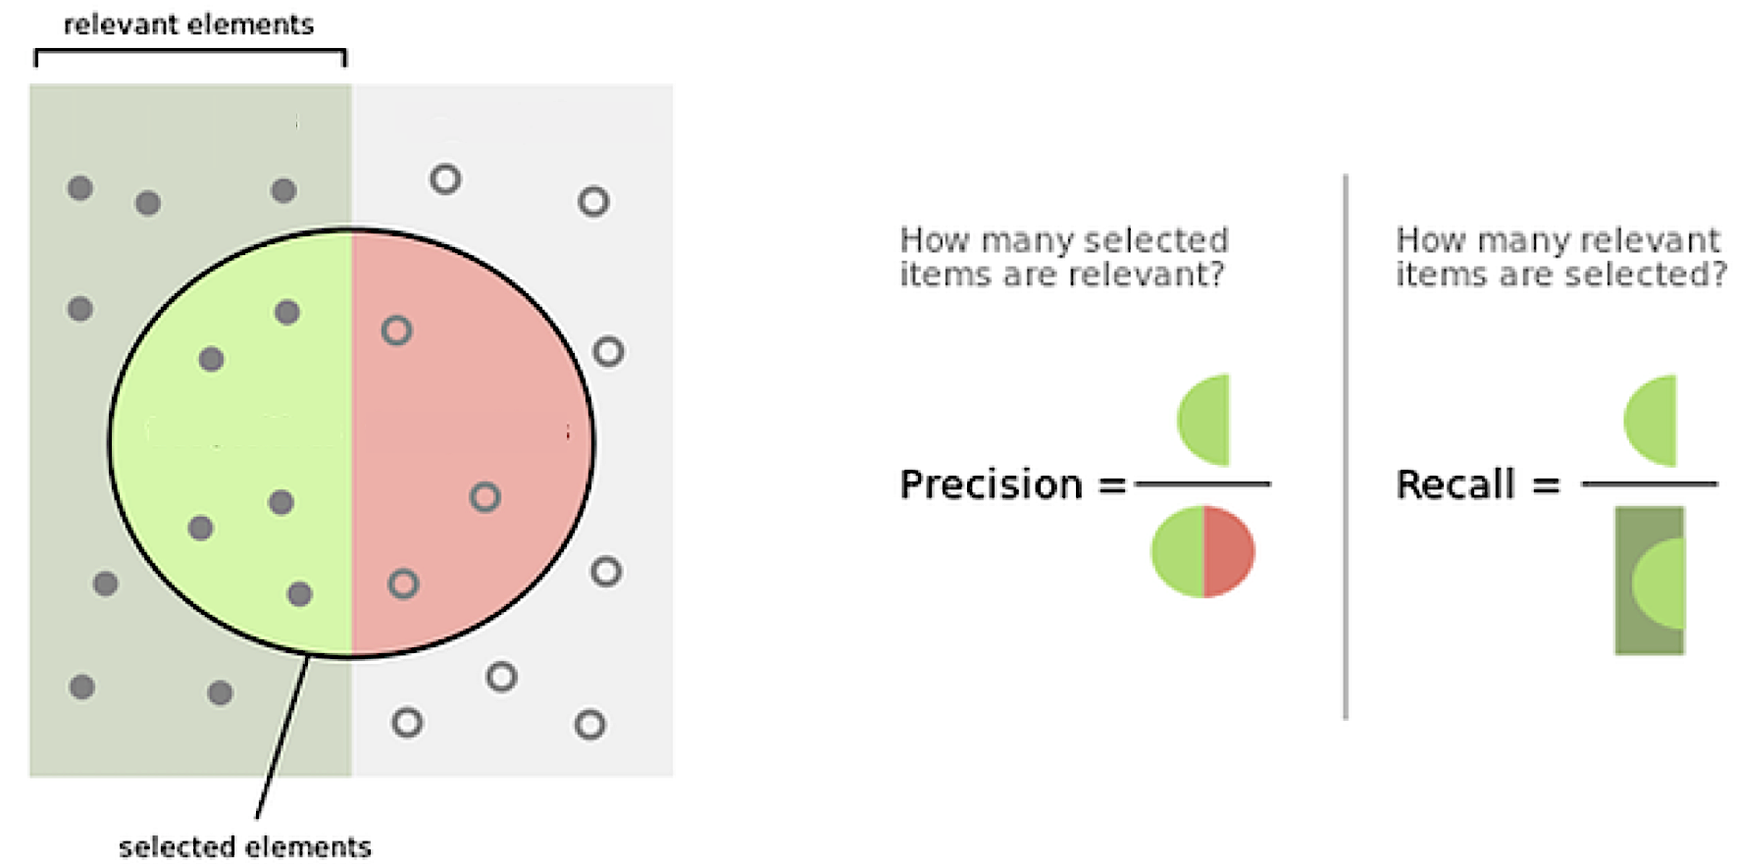
How do we answer our research questions?
We want to find what conditions are true about the input parameters when a specified output occurs. For example, public opinion = 100.
Adapt two information retrieval measures to get:
Correlation
Coverage
Combine them into a single term.
Applying statistical debugging for enhanced trace validation of agent-based models. Simulation 93.4 (2017): 273-284

Slide 16
How do we answer our research questions?
We want to measure the extent to which a condition (i.e. proposition about input parameters) is true with respect to:
A simulation run that results in public opinion = 100. (Precision / Correlation)
ALL simulation runs that result in public opinion = 100. (Recall / Coverage)
For example:
Input Condition: NGOs understand newcomers SVQs for custom activities = TRUE
Applying statistical debugging for enhanced trace validation of agent-based models. Simulation 93.4 (2017): 273-284

Slide 17
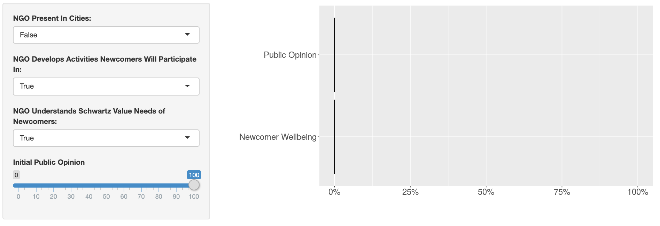
How does the worst case happen?
Worst case is same for wellbeing and public opinion:
No NGO or
NGO develops activities that newcomers will not participate in.
In both cases there is a lack of activities available to newcomers to satisfy SVQ which minimizes well being.
Minimal wellbeing maximizes the frequency of crime which results in low public opinion.
Note: a lack of understanding of newcomer SVQs is not required to avoid a worst case scenario. More important for participatory activities to exist rather than for them to SVQ optimized.
Presence of NGO and development of participatory activities is paramount.

Slide 18
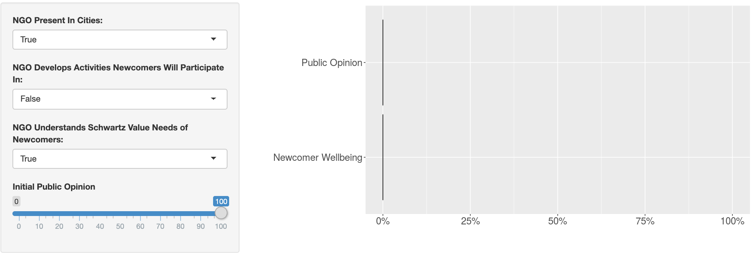
How does the worst case happen?
Worst case is same for wellbeing and public opinion:
No NGO or
NGO develops activities that newcomers will not participate in.
In both cases there is a lack of activities available to newcomers to satisfy SVQ which minimizes well being.
Minimal wellbeing maximizes the frequency of crime which results in low public opinion.
Note: Initial Public Opinion = 0 is not included. This means that NGOs should be placed in cities regardless of residential opinion of the city’s management of newcomers.
Initial Public Opinion doesn’t matter for avoiding the worst case.

Slide 19
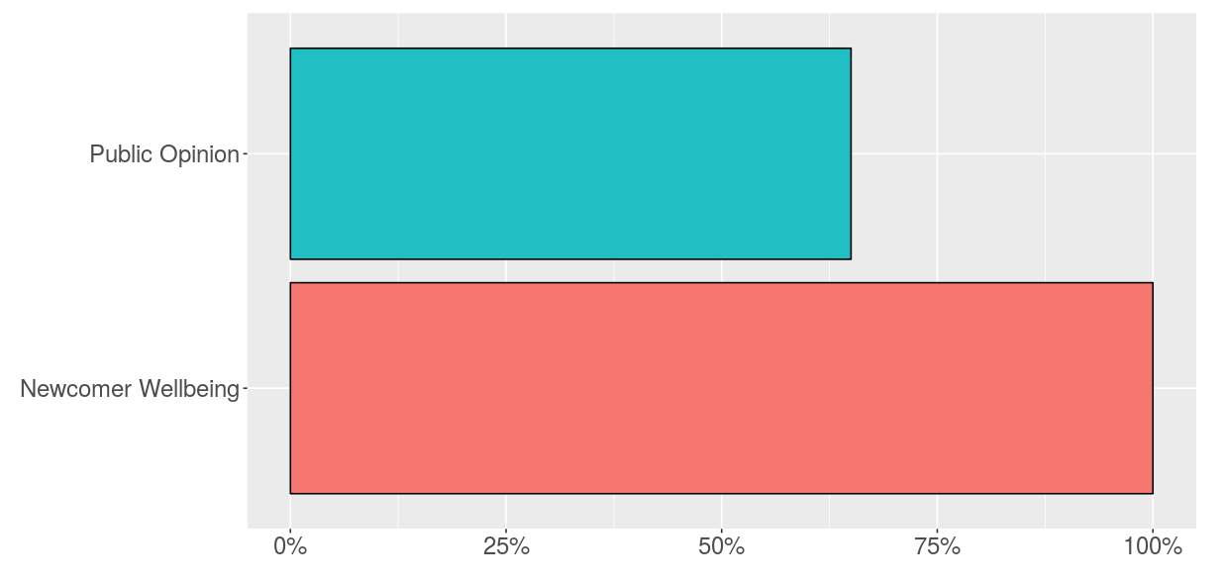
How does the best case for newcomer wellbeing happen?
Best case is same for wellbeing:
NGO
NGO develops activities that newcomers will participate in
NGO understands newcomer SVQs for Custom Activities
Initial Public Opinion is high
NGO / COA / IND
Higher in Open To Change Than Conservation
Higher in Self-Transcendence Than Self-Enhancement
Note: This is not the best case for public opinion.
The input parameters that maximize newcomer wellbeing do NOT maximize public opinion.

Slide 20
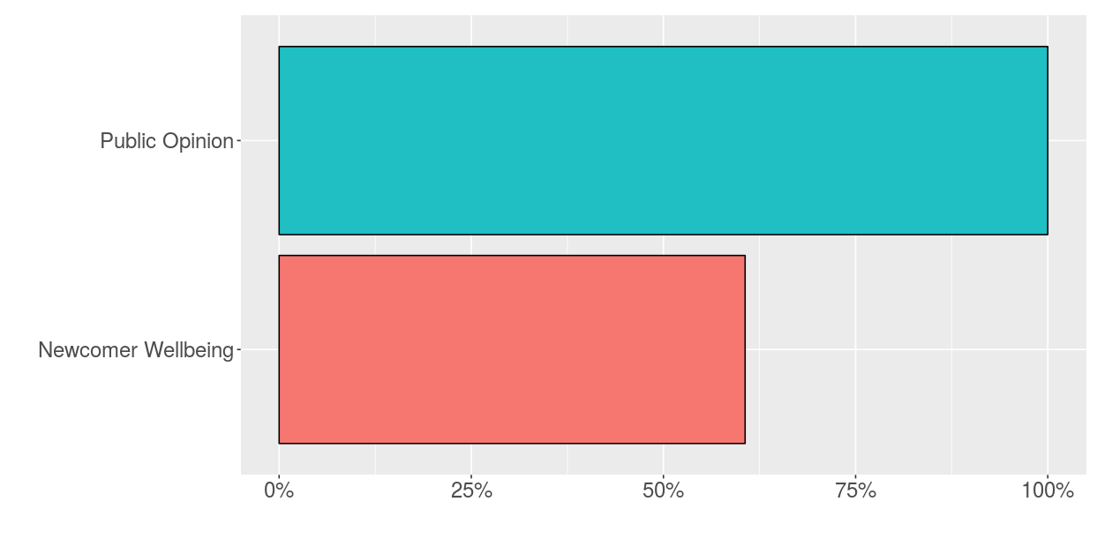
How does the best case for public opinion happen?
Best case is same for wellbeing:
NGO
NGO develops activities that newcomers will participate in
NGO understands newcomer SVQs for Custom Activities
Initial Public Opinion is high
NGO / COA
Higher in Open To Change Than Conservation
Higher in Self-Transcendence Than Self-Enhancement
IND
Open To Change = Conservation
Self-Transcendence = Self-Enhancement
The input parameters that maximize public opinion do NOT maximize newcomer wellbeing.

Slide 21
Conclusions
High-Level Recommendations:
NGOs providing activities what newcomers will participate in is paramount.
Worry less about optimizing custom activities to meet SVQs or initial public opinion of management of newcomers in cities.
Institutions SVQ Actions work well when openness to change and self-transcendence are prioritized over conservation and self-enhancement.
IND SVQ Actions create a tradeoff in terms of well being and public opinion of management of newcomers. Implement your strategy accordingly.
Enable High-Level Decisions: Avoid Worst Case; Create Environment For Best Case

Slide 22

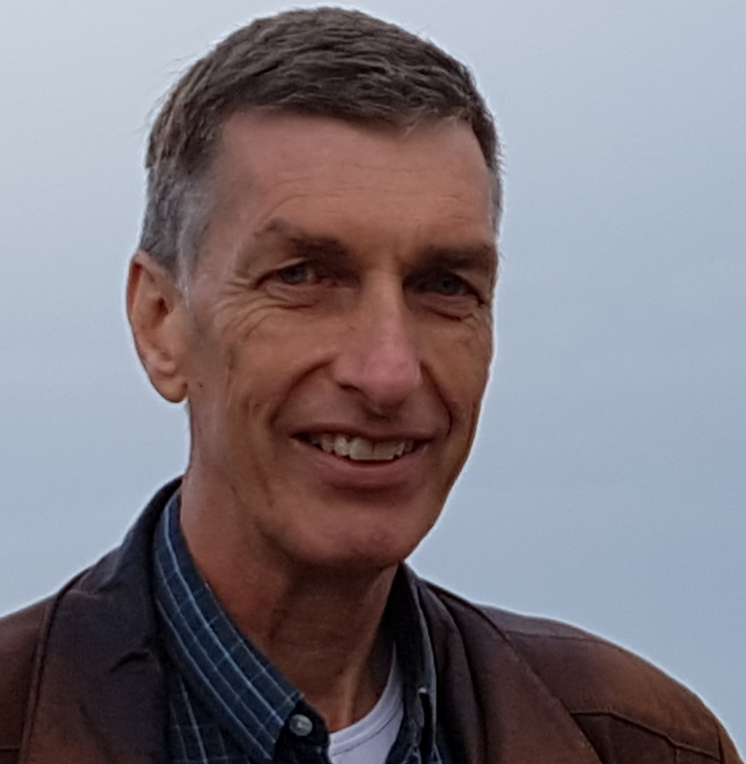
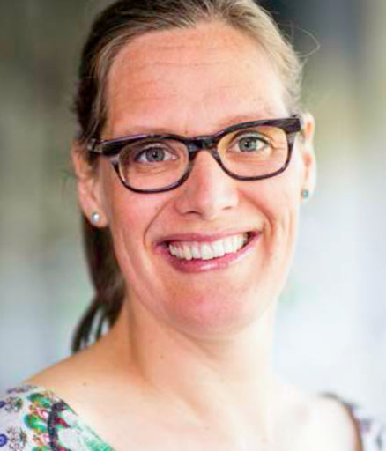
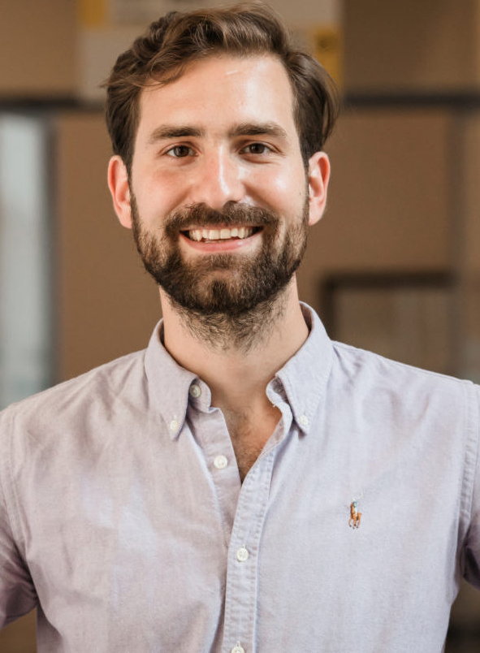
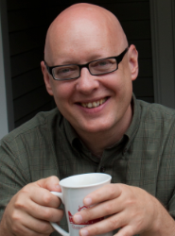
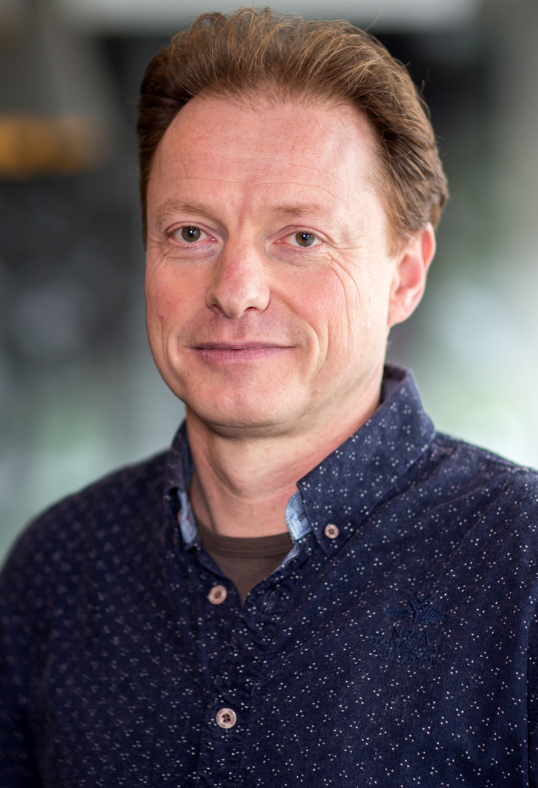
Teamwork Makes the Dream Work
Ross Gore
Old Dominion University / VMASC United States
Data Science
Frank Dignum
Utrecht University
Netherlands
Information & Computing Sciences
Christine Boshuijzen - van Burken
Eindhoven University of Technology
Netherlands
Ethics of Technology
Phillip Wozny
Utrecht University
Netherlands
Information & Computing Sciences
F. LeRon Shults
University of Agder / NORCE
Norway
Philosophy & Theology
Lamber Royakkers
Eindhoven University of Technology
Netherlands
Ethics of Technology
Multidisciplinary Multinational Group Effort

Slide 23

Funding Makes The Research Possible
Funding Acknowledgements

Slide 24
Want More? You’re In Luck.
Check out the website and play with the metamodel:
https://rgore-vmasc.shinyapps.io/integration-model/
Link also in paper.
Read Phillip’s Thesis
https://dspace.library.uu.nl/bitstream/handle/1874/368153/Masters-Thesis-Phllip-Wozny%281%29.pdf
Name of thesis to search for on Google Scholar in paper.
Read Christine’s Conference Publication
https://research.tue.nl/en/publications/a-proposal-for-a-value-sensitive-design-approach-to-modelling-the-2
Title: A Proposal for A Value Sensitive Approach to Modeling The Refugee Chain
Get the full agent-based model up and running
https://github.com/phillipjw/humanitarian_logistics
Requires Python and Mesa to be installed
Um, I said, the party isn’t over

Slide 25


Thank You & Questions
This is high quality research so if you hated it, then its entirely my fault as presenter.

